Slide 1

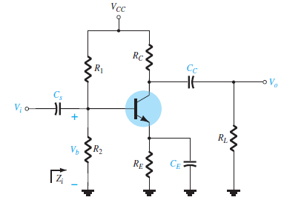
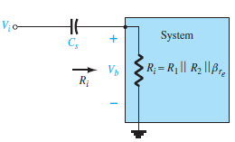




University of Diyala Engineering College
Department of Communications Engineering
Electronics II : 3^{ed} Year - 2015/2016 By: Hussein Ahmed Mahmood
LOW-FREQUENCY RESPONSE - BJT AMPLIFIER WITH RL
The analysis of this section will employ the loaded (R_{L}) voltage-divider BJT bias configuration introduced. For the network of Fig. 2, the capacitors C_{S}, C_{C}, and C_{E} will determine the low-frequency response. We will now examine the impact of each independently in the order listed.
Fig. 1
Loaded BJT amplifier with capacitors that affect the low- frequency response.
Fig. 2
Determining the effect of C_{S} on the low-frequency response.
C_{S} Because C_{S} is normally connected between the applied source and the active device, the general form of the RC configuration is established by the network of Fig. 2.
R_{i} = R₁ // R₂ //βr_{e}
The cutoff frequency defined by C_{S} is:

Slide 2
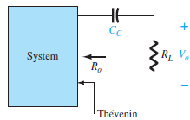
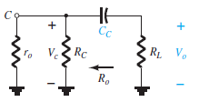





University of Diyala Engineering College
Department of Communications Engineering
Electronics II : 3^{ed} Year - 2015/2016 By: Hussein Ahmed Mahmood
Fig. 3
Determining the effect of Cc on the low- frequency response.
Fig. 4
Localized ac equivalent for C_{C} with Vi = 0V.
Cc Because the coupling capacitor is normally connected between the output of the active device and the applied load, the RC configuration that determines the low-cutoff frequency due to Cc appears in Fig. 3. the cutoff frequency due to Cc is determined by:
C_{E} The cutoff frequency due to C_{E} can be determined using the following equation:
The gain for the network determined by:

